Slide 1
8D Report
for cosmetic issue of BFX – UH200 (T99X202)
Date : 27 July 2020
Prepared by: Heng Ruan
1

Slide 2
D1. Establish the Team
Team Leader: David Yin
QA: Deng Wei Gen
PQE: Heng Ruan
PM: Ben Trinh/ Nelly Ruan
PD: Wen Yong
PE: Mark Wu/Vu Hue
IE: Thu Hang/Van Quyen
SQE: Ken Pham/Xuan Khoa
1

Slide 3
D2. Description of the Problem
Issue Description
24 Jul 2020, ALT customer complain [BFX-UH200] 1st Mass production Cosmetic issue.
Defect Total
• OBA report is missing on the pallet -all (4 pallet)
• UHD label is tilted -about 0.5%
• Inner sheet missing –3box
• Giftbox printing shifted –1pcs
• Carton contamination 2 box
1

Slide 4
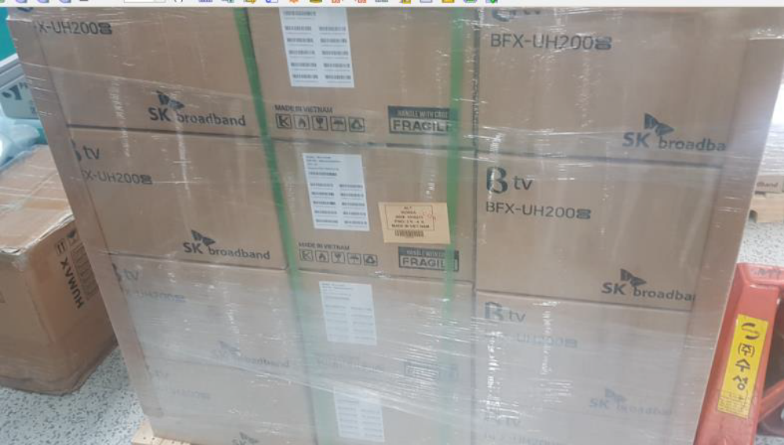
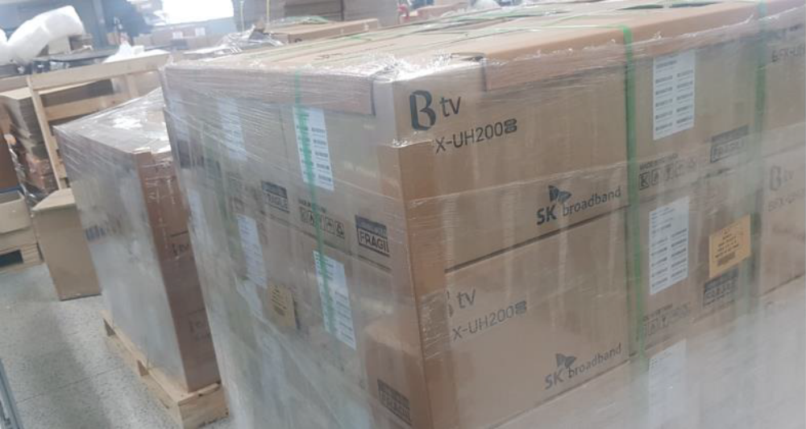
D2. Description of the Problem (continue)
2.1 OBA report is missing:
•Defect carton Q’ty : 4 pallet / 4 pallet
•Defect rate : 100%
•All pallet was missing OBA report on the pallet
1

Slide 5
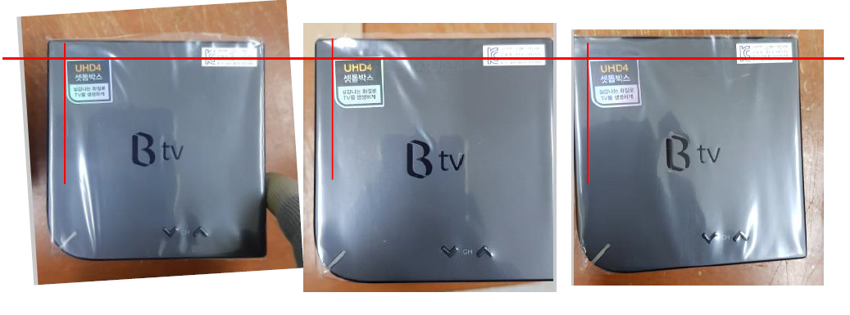
D2. Description of the Problem (continue)
2.2. UHD label is tilted:
•Defect carton Q’ty : 5pcs / 1000pcs (Not counted)
•Defect rate : about 0.5%
•SN:21496870012020005000012/21496870012020005000008/21496870012020005000047/21496870012020005000041/21496870012020005000090. Not all counted.
1

Slide 6
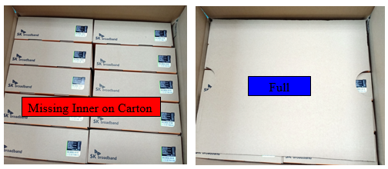
D2. Description of the Problem (continue)
2.3 Inner sheet missing on Carton box:
•Defect carton Q’ty : 3 carton / 100 carton
•Defect rate : 3%
•Inner sheet of top side was missing
BOX number : SKBUH220060002, SKBUH220060077, SKBUH220060097
1

Slide 7
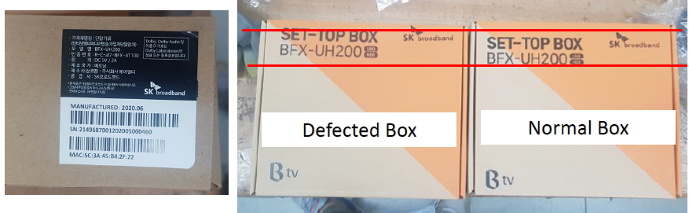
D2. Description of the Problem (continue)
2.4 Gift box printing shifted:
•Defect carton Q’ty : 1pcs / 1000pcs
•Defect rate : 0.1%
SN:21496870012020005000460
1

Slide 8
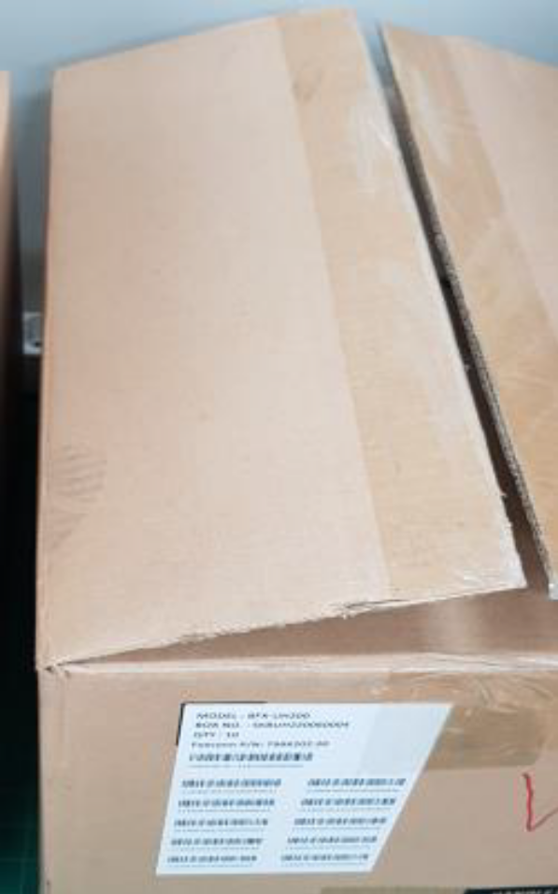
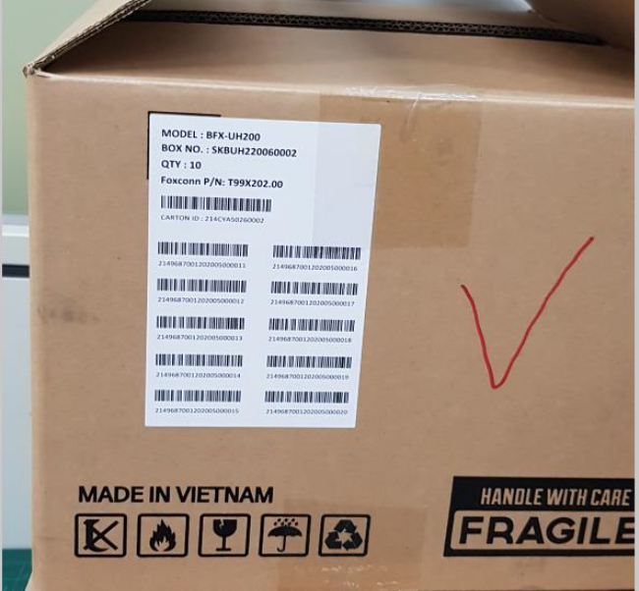
D2. Description of the Problem (continue)
2.5 Carton box contamination:
•Defect carton Q’ty : 2 Carton / 100 Carton
•Defect rate : 2%
•BOXnumber : SKBUH220060002, SKBUH220060004
1

Slide 9
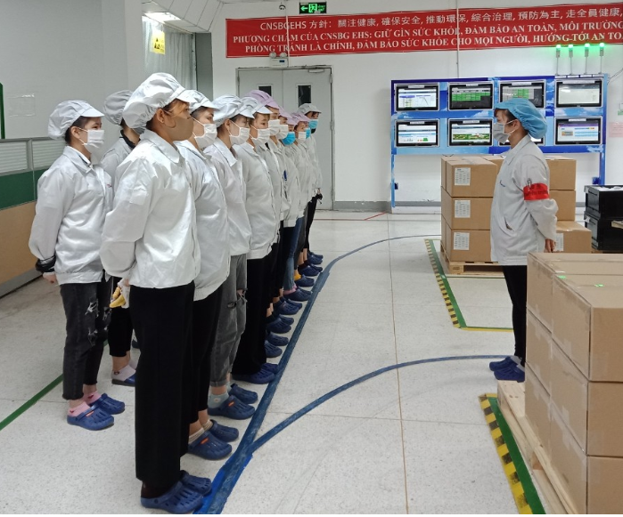

D3. Containment
Immediately notice this issue to all line leader & operators at production line and hang quality alert to all related working stations (IQC incoming material inspection station,VI station, Packing, OBA station, Shipping station) on 7/25 when we get customer feedback issue.
Owner: IQC/PQE/PD/PE/IE/SQE: Ken,Heng Ruan, Wen Yong, Vu Hue, Van Quyen, Xuan Khoa
Done : 25 Jul 2020
1

Slide 10
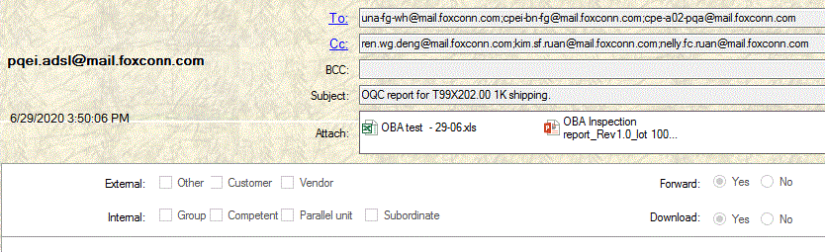
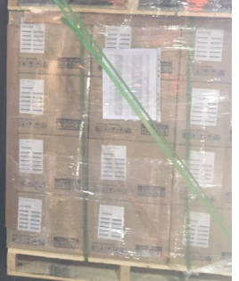
D4. Identify the Root Cause
4.1. OBA report is missing:
Occur Cause : The DN 5028019958 shipping schedule is on 29-Jun, PQE had send mail to FG OBA inspection report was done and printed on 29-Jun. Due to it was changed to 01-Jul (1 shipping day late), the OP at stock forgot to add the last pallet when shipping this lots.
Escape Cause: The OQC check shipping data and pallet before shipping product, he forget to check this item because OBA inspection report was not defined on SIP shipping. So PQE will update this item to check on SIP.
29-Jun PQE send mail provide OQC report for shipping 1K lot
OBA Inspection report add to the last pallet when shipping
Missing OBA inspection report on pallet when shipping
Conclusion: On 29-Jun, PQE had send OQC report to FG for shipping 1K lot, FG stock had printed out OBA inspection report but forget add that report to the pallet, CQA OP don’t find out missing OBA inspection report when shipping.
1

Slide 11
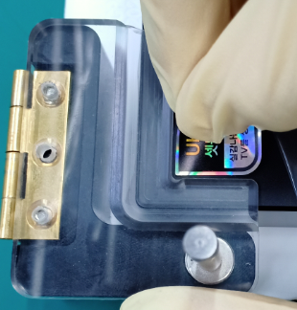
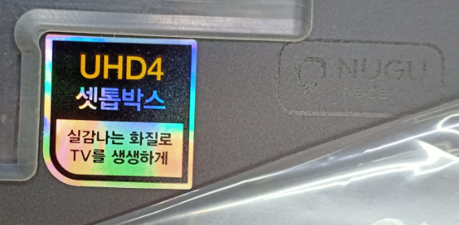
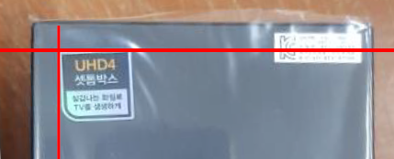
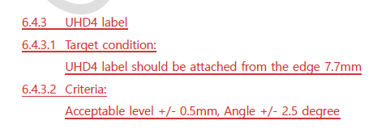
D4. Identify the Root Cause
4.2. UHD label is tilted
Occur Cause: At pasting UHD label period, OP used tool to paste label follow SOP define, but it can paste tilted about 0.03MM, 1.5 degree.
Escape Cause: OP VI check UHD label follow criterial spec is OK, then pass to the next station.
UHD label paste on housing OK
UHD label paste on housing is tilted
UHD4 label criteria spec
Conclusion : OP used tool for pasting UHD label, and VI check is tilted visual still in criteria spec which customer approved.
1

Slide 12
D4. Identify the Root Cause (continue)
4.3. Inner sheet missing on carton box.
Escape Cause : Because this product packing requirement follow SN continue list, in SOP only fix 01 OP. due to many operations, 1 OP can not respond all. And then add 1 OP to support- total 2 OP at packing CTN station, but they don’t separate its working flow clearly. Maybe he forgot to put the inner sheet on carton box
Occur cause: Pack CTN new operator in B06 production line was also performed by himself, he did not check carefully lead to defect escaped.
Conclusion: Pack CTN operator did not check carefully lead to defect escaped.
1

Slide 13
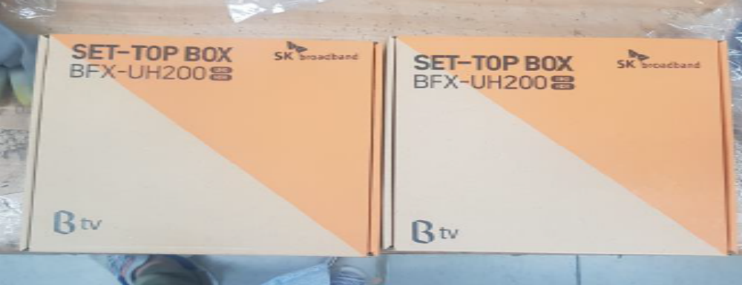
D4. Identify the Root Cause (continue)
4.4. Gift box printing shifted :
Occur Cause: Incoming material issue, had feedback to vendor for improved all Box printing for BFX-AT100 and BFX-UH200.
Escape Cause: At Pack Box station and check weight, OP online is difficult to find the printing shifted issue. So escape this issue to customer side.
GiftBox printing shifted
GiftBox printing OK
Conclusion : Giftbox printing shifted cause is incoming material, OP online can not find for this issue.
1

Slide 14
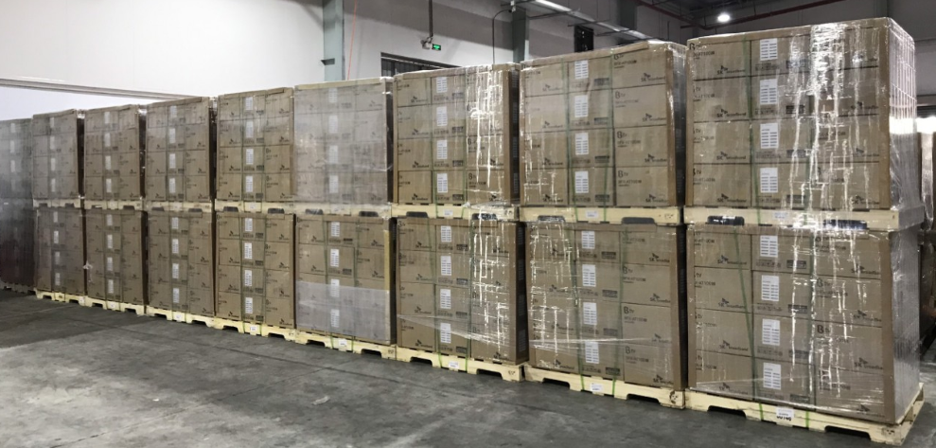
D4. Identify the Root Cause (continue)
4.3 Carton box contamination
Occur cause: This is material incoming issue, vendor have to improve this issue.
Escape cause: At Pack pallet, the OP didn’t check this issue carefully, and before shipping, all pallet had roll around mylar on pallet and then move to the waiting shipping area, CQA and finish good stock can’t detect out carton dirty issue.
Carton box have dirty
Carton box have foot print
Pallet roll around mylar at FG, waiting shipping.
Conclusion:. Carton dirty cause is incoming material, OP online can not find out this issue.
1

Slide 15

D5. Corrective Action
5.1 OBA report is missing on the pallet :
Short term action
5.1.1. Re-check all Shipping report of CQA from the first lots to now, have only T99X202.00 shipping 1K lot missing OBA inspection report.
5.1.2. Alarm and remind OP finish good stock and CQA employment about missing OQC report.
Owner: FG: Wen Thiet Due date: 25 Jul 2020 →Done
Owner: CQA: Wen Xiu Due date: 25 Jul 2020 →Done
Long term action
5.1.3. Add more specially item check “ OBA inspection report ” in SIP shipping for CQA doing before shipping with OTT product.
Owner: PQE: Heng Ruan Due date: 28 Jul 2020
1

Slide 16


D5. Corrective Action
5.2 UHD label is tilted :
Short term action
5.2.1. Add NG picture to SOP, Remind OP paste label station and Check visual inspection station this issue.
Owner: IE: Wen Quyen Due date: 27 Jul 2020 →Done
Owner: PD: Wen Xiu Due date: 27 Jul 2020 →Done
Long term action
5.2.2. Add NG picture and remind OBA visual inspection SIP.
Owner: PQE: Heng ruan Due date: 27 Jul 2020 →Done
5.2.3 Add Golden sample and tool check UHD label at OBA visual inspection station when T99X202.00 run new work order.
Owner: PQE: Heng Ruan Due date: 13 Aug 2020
1

Slide 17

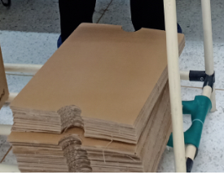
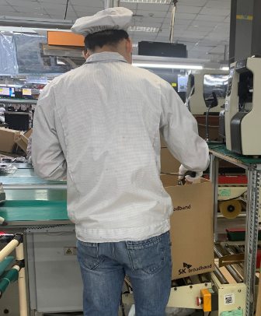
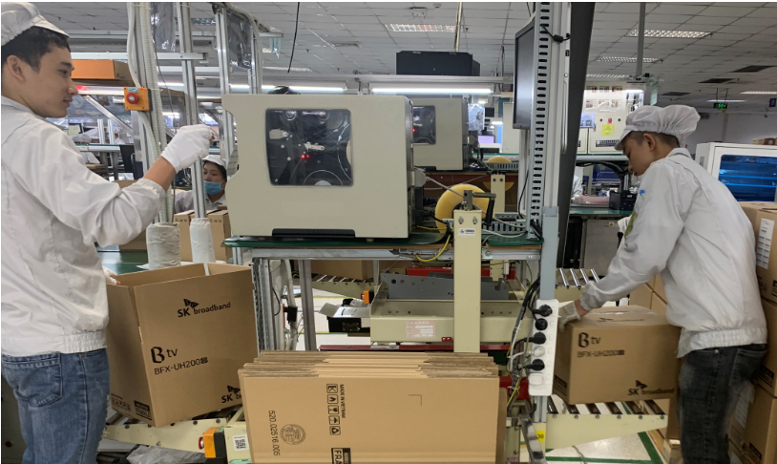
D5. Corrective Action
5.3. Inner sheet missing
5.3.1. Action: In SOP – fixed 2 OP at this station and separated the operation for each person clearly.
Owner: IE: Van Quyen Done: 03 Jul 2020
5.3.2. For 01 pallet have 32 carton, So PD will take 64 pcs inner sheet one time for doing 01 pallet done ( cause 01 carton used 2 inner sheet ), then will take other 64 pcs inner sheet to make next pallet.
Owner: PD: Wen Yong, Done: 03 Jul 2020
Before Improved | After Improved
SOP Fix 01 OP at Box weight & pack Pallet station. | SOP Fix 02 OP at Box weight & pack Pallet station.
64 pcs Inner sheet separate online
Box weight & Pack Pallet station
1

Slide 18


D5. Corrective Action
5.4. Giftbox printing shifted
5.4.1. SQE inform printing shifted on Box to vendor and request improved report from vendor. Inform to IQC for control incoming material inspection.
Owner: SQE: Van Khoa, Due Date : 25 Jul 2020
5.4.2. Remind and alarm the OP online and IPQC about the printing shifted gift-box issue online product.
Owner: PD/IPQC: Wen Yong, Wen Xiu, Due date: 25 Jul 2020
5.4.3. Add NG Giftbox picture to SOP for OP remind this issue.
Owner: IE: Wen Quyen, Due date: 28 Jul 2020
1

Slide 19

D5. Corrective Action
5.5. Carton contamination
5.5.1. Add NG picture to SOP pack CTN station and pack pallet station, remind all OP to know and reject any Carton dirty cosmetic issue.
Owner: IE: Wen Quyen Done: 28 Jul 2020
5.5.2. Remind IPQC to know and reject any Carton dirty cosmetic issue when audit online.
Owner: PQE: Heng Ruan Done: 28 Jul 2020
1

Slide 20
D6. Verification of effectiveness
6.1. Quality alert and SOP were already updated in inspection requirement and hang on production line, IPQC keep audit and verifying the implementation on production line.
6.2. Operators were reminded and trained to know this issue for more pay attention to their job, compulsory follow standard operation procedure.
1

Slide 21
D7. Prevent recurrence
7.1. Line leader remind all operators before production and monitor their operating daily.
Owner: PD: Wen Yong Done : 25 Jul 2020
7.2. IPQC will random sample check after VI and pack box station to recheck product and package status.
Owner: PQE: Heng Ruan Done: 25 Jul 2020
7.3. RD/PM team work with customer to finalize cosmetic UHD criteria spec (especially for acceptable level and Angle degree ).
Owner:PM-Henry Chiou –due date- 15 Aug 2020
1

